Slide 1
The Shell
a.k.a. The Terminal

Slide 2
Outline
What is this shell thing?
Command options
man
apropos
pwd
ls
cd
cp
mv
mkdir
rm
PATH
Text editors
Aliases

Slide 3
What is the shell?
The shell ( bash, sh, csh, etc ) is a programming language
But fear not! A large amount of its utility lies just at the surface
The simplest rule that trips most people up
Spaces, a space bar hit, counts as part of the sytax
i.e. a =2, a= 2, and a = 2, none of these will set ‘a’ to 2
But a=2 will get you to ‘a’ being set to 2

Slide 4
Command options
Command options, also known as flags or switches, are modifiers to shell commands, such as the ones we will see in the following slides
They are denoted either by a space and a single or a double dash followed by either a single letter or a word, respectively, examples below
-a
--verbose
These options modify commands, single letters can be chained together, i.e. –abc while double dash commands can not
Options always follow their commands before anything else and are preceded by a space

Slide 5
man
Short for manual, allows you to read said manual for just about every shell command out there
man man <enter> will bring up man’s help page
man opens the manual in a text editor called ‘less’ all you need to know is
Up and down arrow keys do what you would expect
Page up and page down keys do what you would expect
<</[term]>> <enter> will search the manual page for ‘term’
<.> hitting the period key will bring you to the next search result
<h> displays less’s internal help menu ( man less ) will also display
<q> quits you out of less and back to the terminal

Slide 6
apropos
man is great if you know the name of the command, but what if you want to know if a command exists?
apropos “[term]” will search all the man pages for ‘term’ and return a list of the commands with a number for how many times ‘term’ showed up
i.e. apropos “text editor” will search for ‘text editor’ and might return output looking like
ed(1), red(1)
vim(1)

Slide 7
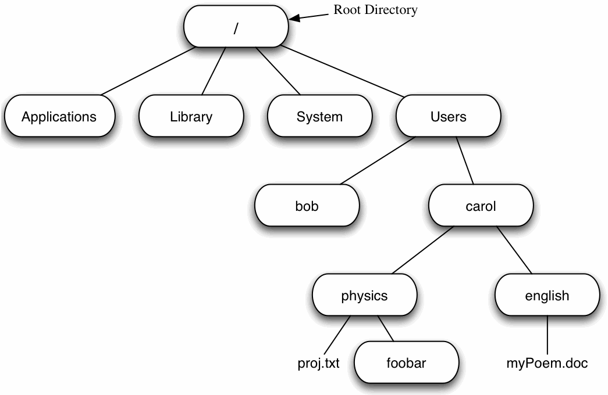
pwd
pwd < enter > will print out your current location in the file tree
Figure 1. A depiction of a UNIX file tree
courtesy of: acad.coloradocollege.edu
If we are here, pwd would display
/Users/carol/english
The tilde, ~ , is a shortcut for your home folder ( the folder bearing your username for most people
As such, in this case pwd ~
would take us to
/Users/carol
A period, ‘ . ‘ , means the current directory and two periods, ‘ .. ‘ , means one directory above

Slide 8
ls
ls < enter > displays the contents of the current directory
ls has many fun options to modify its display
ls –la for example displays all files, including hidden ones, and provides you meta data about said files

Slide 9
cd
cd allows you to change the directory you are in, simply provide it an absolute ( starting with root ) or relative path.
For example starting in the directory ‘ carol ‘
cd /Library
cd ..
cd .
cd /Users/bob
cd english
cd physics/foobar

Slide 10
mv
mv allows you to move files around, mv –r will let you move directories
mv [/path/to/file1.txt] [/new/location/new_name.txt]
As seen above, it also allows you rename files, though you can type in their old name to keep the name the same.
Using mv you can simply rename a file where it stands
mv old_name.png new_name.png

Slide 11
mkdir
mkdir [name] allows you make new directories with the name ‘name’

Slide 12
rm
NEVER NEVER NEVER NEVER NEVER….NEVER USE
rm –rf *
rm [term] deletes whatever file or directory matches ‘term’ according to REGEX rules
REGEX ( or ‘regular expressions’ is a pattern matching language used to find strings
covering it is beyond the scope of this tutorial
all you need to know is that if you put the name of a file as ‘term’ that will work
also, say, to delete all text files, you can input *.txt to do so
* means ‘match any number of any things’
so, Hw*.txt would match Hw.txt, Hw1.txt, Hw4b.txt and many others
Unlike Windows when you delete something in Unix, it is GONE
-r indicates recursive ( go into any directories that match the name )
-f indicates ‘force’, don’t ask before deleting things

Slide 13
PATH
The path variable, accessed by echo $PATH is essentially a list of places your computer will look for things that programs ask it for
Entries are separated by ‘:’
To add something to your path for ONE USE ONLY do this
PATH=$PATH:thing/you/want/to/add
To add something more permanently, modify the path variable found in the .bashrc or .bash_profile file in your home directory

Slide 14
Text editors
You need one, it’s beyond helpful to know how to use one and to use it to modify files from within terminal.
You’re basically a vim, nano, or emacs person
Personally I prefer vim, but the important thing is that you pick one, gain proficiency with it, and stick to it

Slide 15
aliases
aliases are variables that you pre-define for each shell session ( each terminal window is essentially a new instance of ‘the shell’ )
Easiest way is to have a .bash_aliases file which holds all your aliases
This technically requires the lines
if [ -f ~/.bash_aliases ]; then
. ~/.bash_aliases
fi
to your .bashrc or .bash_profile files
You set an alias by putting the below in your .bash_aliases file
alias [something]=‘[string you would type into terminal]’
alias somedir=cd ~/homework/NE101
Having the above alias, typing somedir into my terminal would take me to my NE101 homework folder

